Slide 1
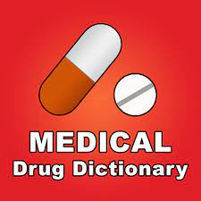
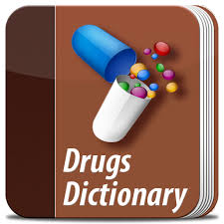
Medication Dictionary Jovelle Patterson jovepatt/Medication-Suggestion (github.com)
If you have a bad feeling research to get you some healing “The Medication Dictionary”
The medication dictionary is used to help you find medication that can help with any symptoms you maybe having.

